Slide 1

Production of aluminosilicate proppants from aluminium salt slags

Slide 2
Project investment summary
Unique highly profitable technology for the processing of waste salt slag
Solving of ecological
problem
The territories adjacent to aluminum smelters are filled with salt slag, polluting the territory and creating a threat to environmental safety
Project - creation of a safe system for cleaning existing and new slags .
Unique technology
Our team has developed and successfully utilized the proposed technology
Complete extraction of valuable fractions and their use for re-production or processing into a finished product (aluminum flux, aluminum ingot, salts)
Established business model
The business model was successfully tested on our own small project
The team has a unique experience and the necessary staff for the implementation of the project on an industrial scale
High investment attractiveness
Over $200 million in revenue over 5 full years since project implementation
Highly profitable project with a payback of 2,5 years
Numbers presented for the first 5 years of operation, profitability is significantly higher
NPV (net present value) = $114.6 million on a total investment of $40 million
Platform for further development
Scaling the project and creating similar productions based on the same operating model throughout Russia
Additional technology for the separation of salts and the production of expensive products, incl. aluminosilicate proppants for the oil industry

Slide 3
Project objectives
Solving the environmental problem - creating an effective and safe system for cleaning existing and new slags
The current difficult environmental situation and its risks
The secondary metallurgy of aluminum in Russia is characterized by the fact that salt slags formed during smelting are taken out to open dumps.
In Russia there is (was formed) a large number of dumps of aluminum salt slags located in the territories adjacent to the factories of commercial aluminum production.
In such dumps, up to several million tons of slag accumulate on an area of several hectares.
The penetration of potassium and sodium salts into the soil from the dump leads to mass death of trees and vegetation in a vast area adjacent to the slag dump.
There is also a threat of salt penetration into the groundwater aquifers.
The objective of this project is to improve the ecological situation in the state and the sanitary condition of settlements, as well as to increase the resource efficiency of the economic complex by creating a safe and efficient waste management system, which provides for reducing their generation, maximum processing and use as secondary raw materials and safe disposal.
Our team has a unique experience and the necessary staff of professionals for the implementation of this project on an industrial scale.
Efficient and safe production

Slide 4
Established Business Model
Project history and successful implementation of own small projects
Since 2004, our team of professionals has been actively involved in the development of technology for the processing of waste aluminum salt slags (salt cakes).
In 2010, a wet processing technology for this product was established, which was finalized at a pilot production.
In the period up to 2014, we were quite successful in processing these production wastes to obtain high demand marketable products. Waste dumps in the city of Sverdlovsk (Lugansk region), small volumes in the Donetsk region were used as the basic industrial raw materials. There’ve been also conducted processing of aluminium salt slags from the raw material of dumps located in Russia.
In August 2022, a complex for processing salt slags was launched in the Rostov region (low capacity up to 1000 tons/month).
Work is currently underway to improve the technology and obtain new commercial products
We propose the creation of a similar production facility designed for deep processing of aluminum salt slags (salt cakes)
  The proposed scheme for processing dump salt slags includes leaching of the salt part, filtration of the aqueous solution and its subsequent evaporation to obtain a recycled flux.
  At the same time, with the help of this technology, pure aluminum pellets suitable for melting, as well as neutralized impurities, are obtained.

Slide 5
Technology
Scheme
Salt aluminum slag
Aluminum kinglet
Al₂O₃+SiO₂ (Alumoflus)
A mixture of sodium and potassium salts
Secondary aluminium
АВ-87
Power companies
Transportation
Communal services
Ferrous and non-ferrous metallurgy
Cement industry
Oil & gas industry
Additional potential
It is possible to carry out work on the separation of potassium and sodium salts
Sodium salt
(NaCl)
Potassium salt
(KCl)
5

Slide 6
History of the emergence of a man-made deposit
The waste heap was formed as a result of the aluminium production plant. According to independent studies, this slag can be considered a complex mineral raw material that is in high demand on the market. The main processed products are: metallic aluminium (up to 5%), iron (up to 3%), sodium and potassium chlorides (up to 25% in total), aluminium oxide (50%). These products are used in ferrous and non-ferrous metallurgy, cement industry, oil and gas industry, road construction, at enterprises of the fuel and energy complex, housing and utilities sector.

Slide 7
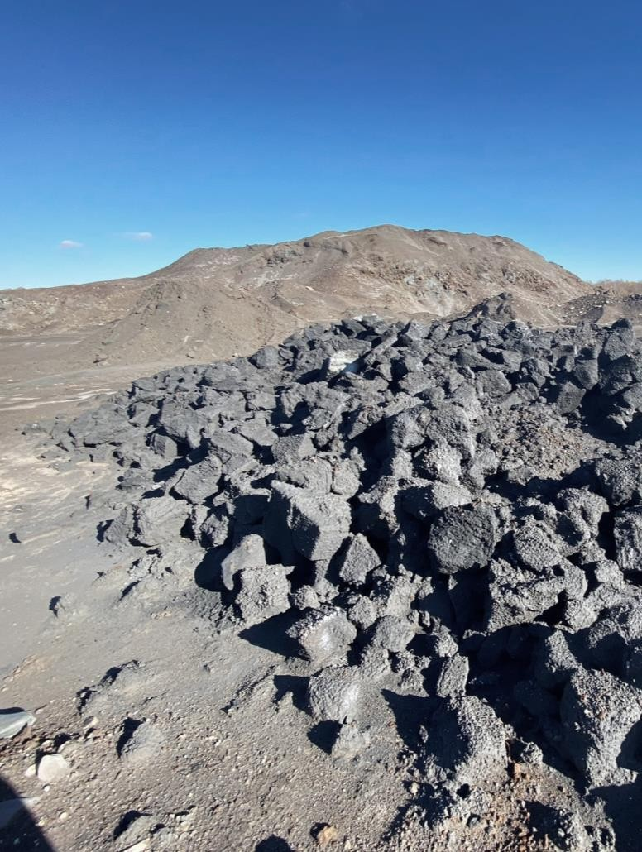
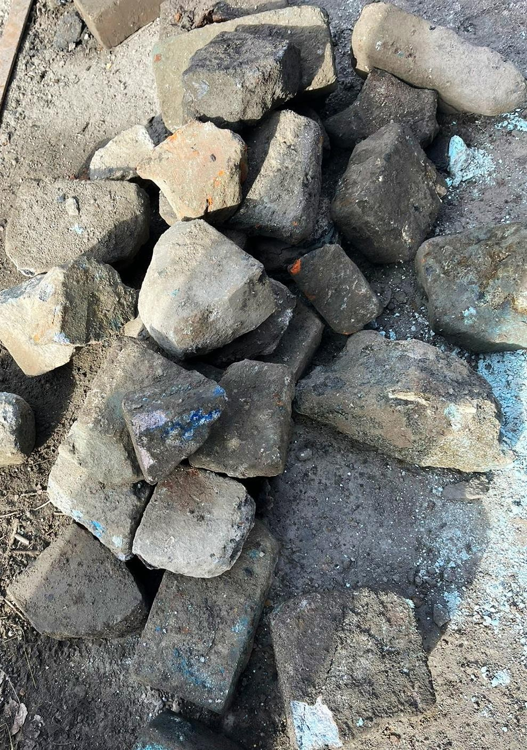
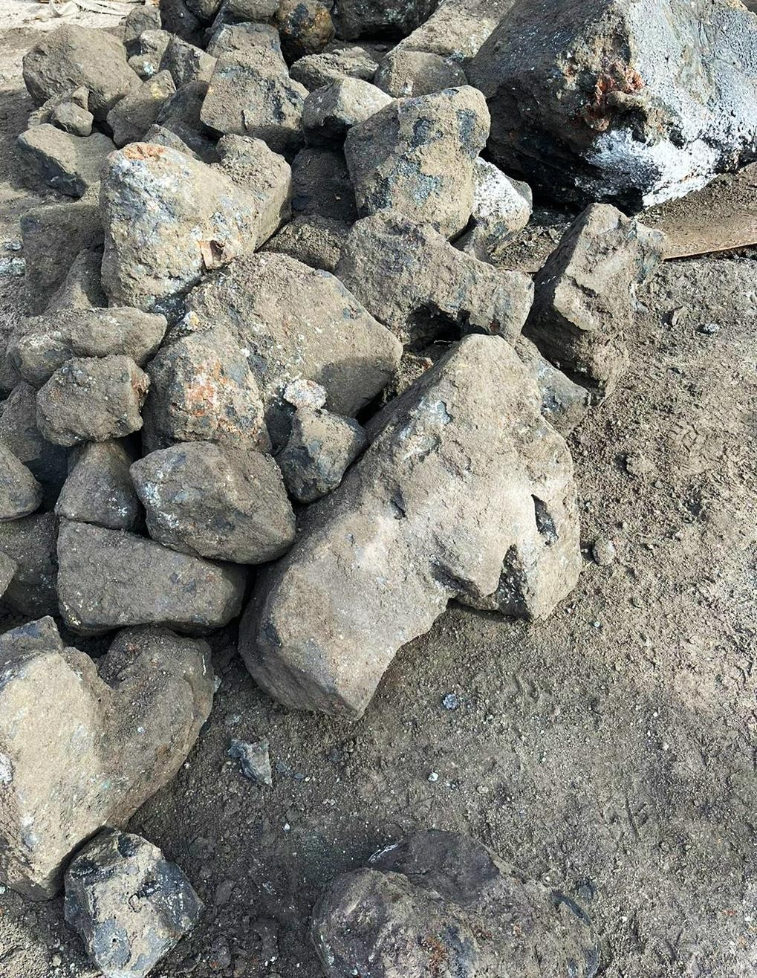
Appearance of the original slag

Slide 8
Chemical composition of raw materials of a man-made deposit
Chemical composition, weight %
Fraction mm | - 0,1 | 0,1 | 0,31 | 0,5 | 2,0 | +6,0 | Average content
NaCl | 11,51 | 10,41 | 10,76 | 11,39 | 11,22 | 11,71 | 11,17
MgO | 5,03 | 4,78 | 5,63 | 5,39 | 5,04 | 4,83 | 5,12
Al2O3 | 56,33 | 57,26 | 55,25 | 52,55 | 52,62 | 51,21 | 54,20
SiO2 | 5,17 | 6,04 | 8,33 | 7,18 | 6,99 | 7,51 | 6,87
P2O5 | 0,11 | 0,11 | 0,11 | 0,11 | 0,11 | 0,12 | 0,11
S | 0,13 | 0,11 | 0,10 | 0,35 | 0,12 | 0,15 | 0,16
KCl | 12,41 | 12,38 | 11,16 | 12,94 | 12,29 | 12,67 | 12,31
CaO | 3,52 | 3,16 | 3,08 | 3,38 | 4,64 | 5,12 | 3,82
TiO2 | 0,29 | 0,28 | 0,34 | 0,36 | 0,29 | 0,25 | 0,30
Cr2O3 | 0,12 | 0,12 | 0,13 | 0,12 | 0,17 | 0,15 | 0,14
MnO | 0,30 | 0,28 | 0,28 | 0,32 | 0,37 | 0,35 | 0,32
Fe total | 3,14 | 3,37 | 3,34 | 4,53 | 4,59 | 4,61 | 3,93
NiO | 0,11 | 0,11 | 0,10 | 0,10 | 0,11 | 0,08 | 0,10
CuO | 0,68 | 0,66 | 0,54 | 0,44 | 0,53 | 0,42 | 0,55
ZnO | 0,69 | 0,52 | 0,48 | 0,46 | 0,56 | 0,52 | 0,54
BaO | 0,24 | 0,22 | 0,19 | 0,21 | 0,19 | 0,15 | 0,20
PbO | 0,22 | 0,19 | 0,18 | 0,17 | 0,16 | 0,15 | 0,18
 | 100,00 | 100,00 | 100,00 | 100,00 | 100,00 | 100,00 | 100,00
* Total content of metallic Al 5-12%

Slide 9
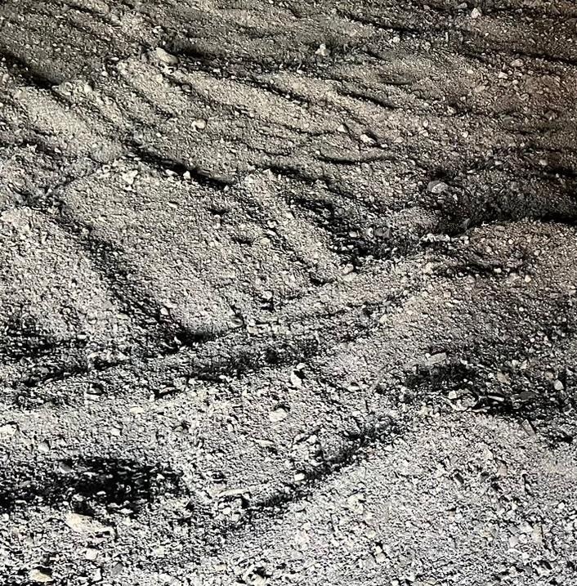
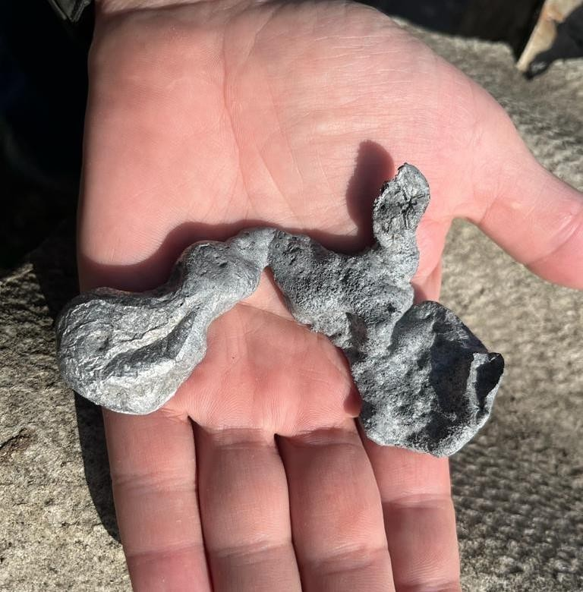
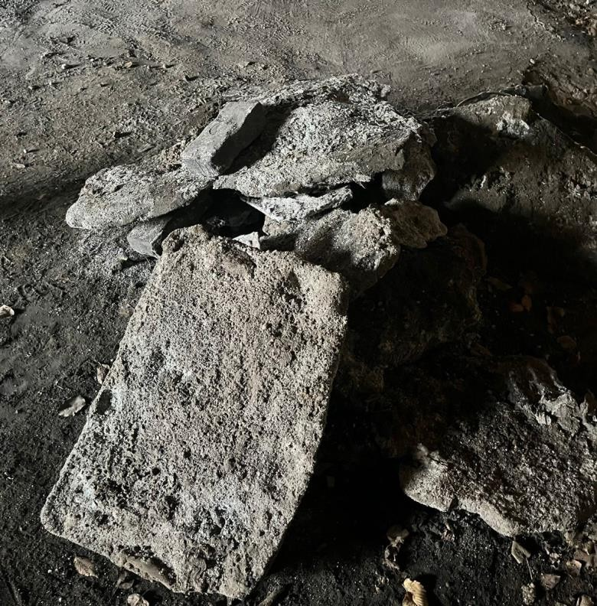
Intermediate processed products (obtained at the operating pilot production facility in the Rostov region)
Small aluminium kinglet
Large pieces of aluminium kinglet
Aluminium plates

Slide 10
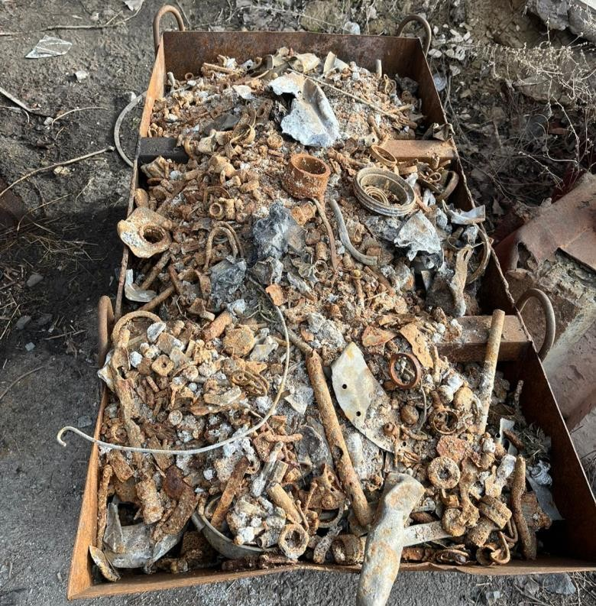
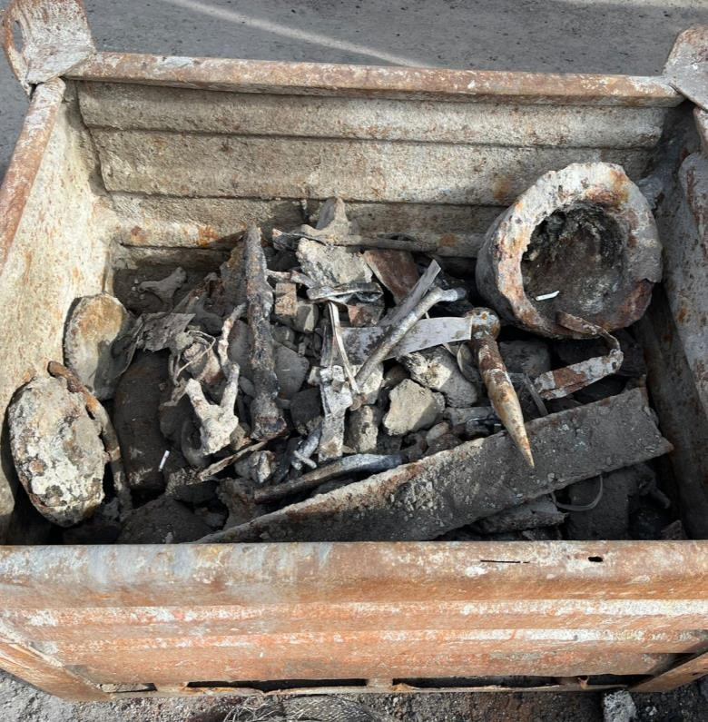
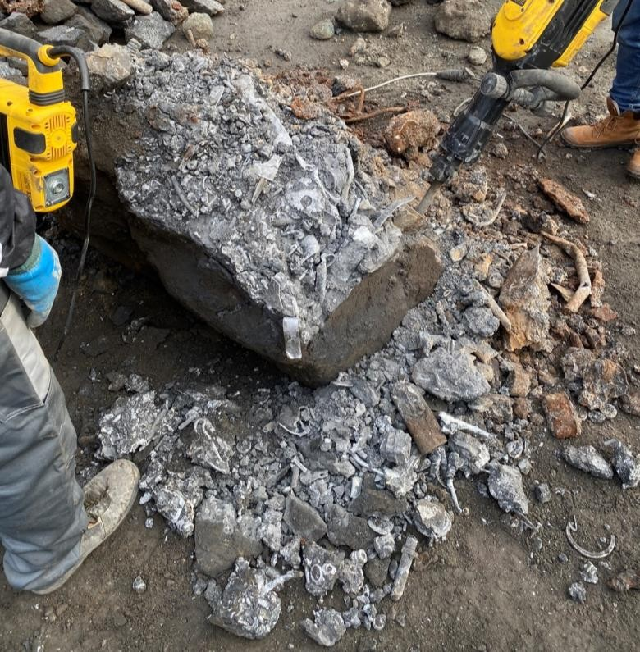
Processed products (obtained at the operating pilot production facility in the Rostov region)
Small iron scrap
Medium iron scrap
Mixed scrap
(Fe, Fe-free)

Slide 11
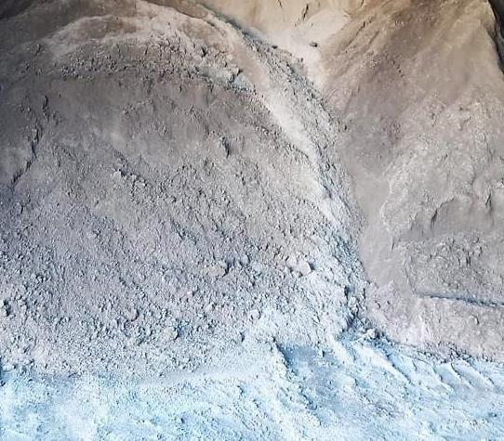
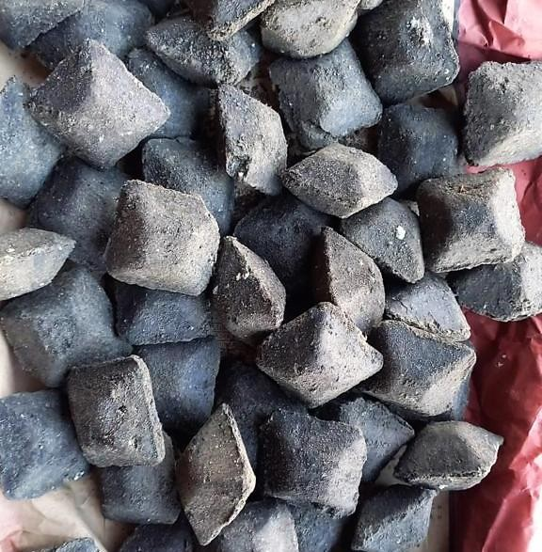
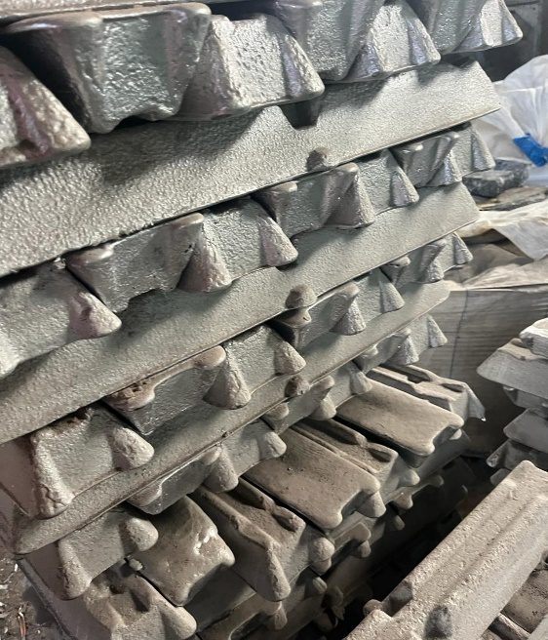
Processed products (obtained at the operating pilot production facility in the Rostov region)
Alumoflux small fraction
Briquetted alumina flux
Secondary aluminium AB-87

Slide 12
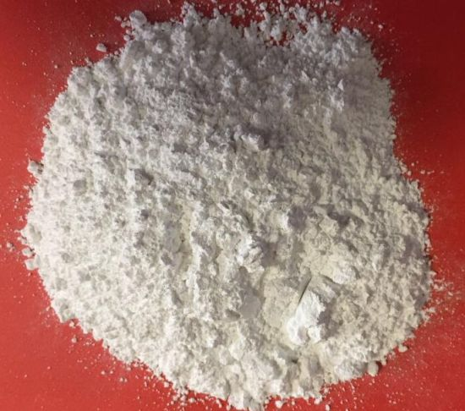

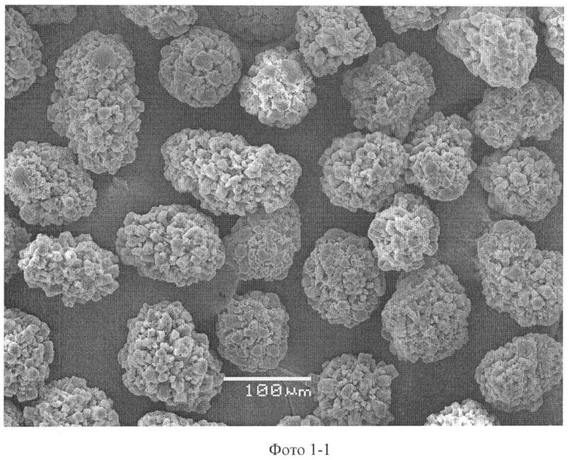
Processed products (obtained at the operating pilot production facility in the Rostov region)
Aluminium oxide prepared for the production of proppants (Al2O3)

Slide 13
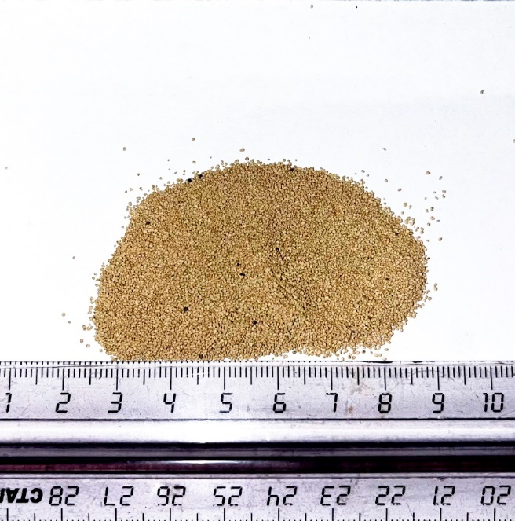
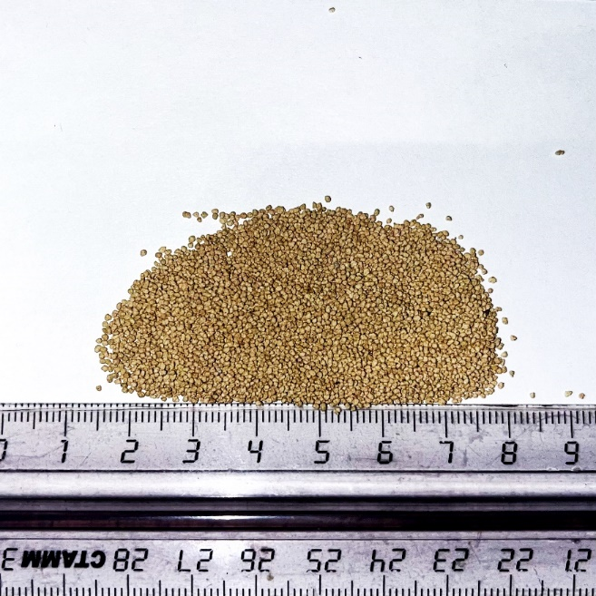
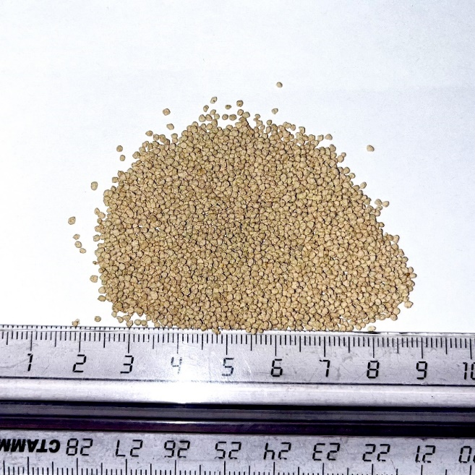
Processed products (obtained at the operating pilot production facility in the Rostov region)
Aluminosilicate proppants GOST R 51761-2013

Slide 14
What is Proppant?
Multi-stage hydraulic fracturing with creation of high conductivity channels
Proppants (from Propping agent) are a granular material used in the oil industry to increase the efficiency of well recovery using hydraulic fracturing technology (HF, MSHF). It is used to secure (prevent closure under rock pressure) cracks created during HF. It is granules of similar size, with a typical diameter of 0.5 to 1.2 mm.
The proppant is distributed inside the crack in clusters, unlike the dense proppant packing in the standard hydraulic fracturing method
the technology involves the creation of a highly conductive crack by forming highly conductive channels between clusters inside the crack
cluster method of hydraulic fracturing
dense proppant packing in standard hydraulic fracturing method
drilling
well
MSHF cracks

Slide 15
Scheme for the sale of commercial products
Oil producing enterprises
PROPANT
A mixture of KCl and NaCl salts
Metallurgical enterprises
2. Own production
Slag processing plant
Sale-purchase agreement
Secondary aluminum AB-87
Metallurgical enterprises
Scrap ferrous and non-ferrous metals
Profile enterprises

Slide 16
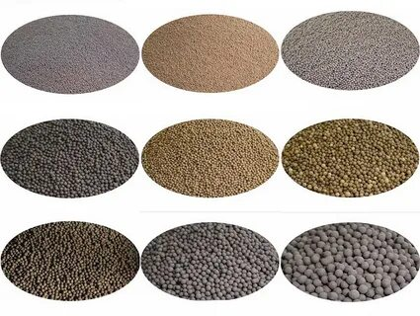
Planned production indicator
Proppant production complex
Oil producing enterprises
Proppant production plant
Recycling
Production
Sale
thousand tons of salt slag per year
250 thd tons of proppants per year
30 thd tons of KCl and NaCl mixture per year
7 thd tons of secondary aluminium per year
10 thd tons of scrap iron
360

Slide 17
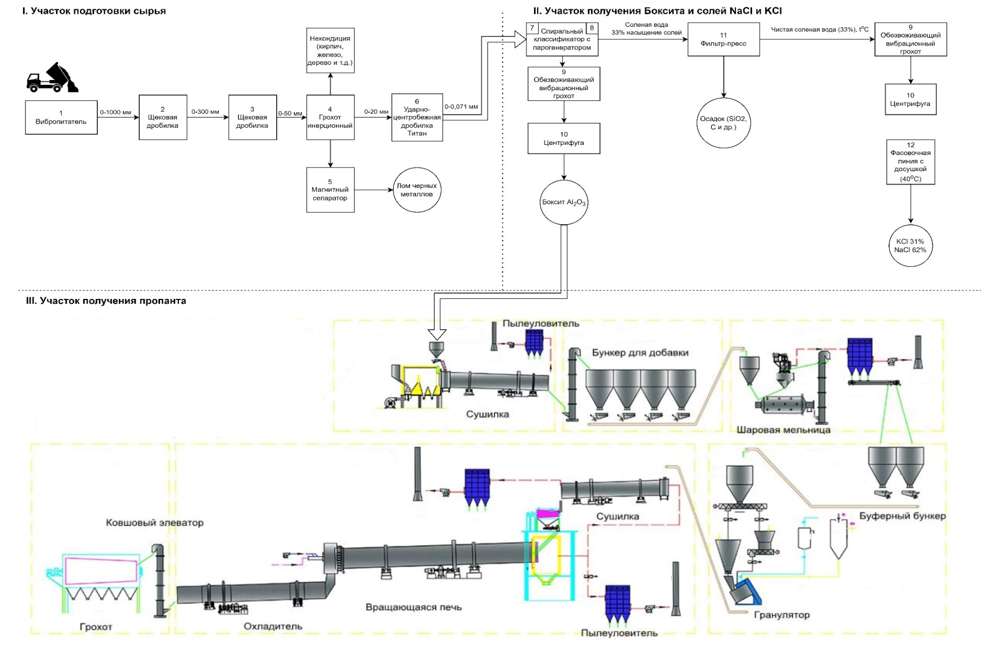
Technological scheme of the production complex (PROPANTS)
I. raw material preparation area
II. bauxite and NaCl and KCl salt production area
III. Propane production area

Slide 18





Technical and economic indicators of the project (?)
Output of finished products:
Proppant – 21 000 t/month
Mixture of KCl and NaCl – 2 400 t/month
Secondary aluminium АВ-87 – 600 t/month
Scrap iron – 900 t/month
3 million tons - raw material reserves (salt slag)
15% salts (KCL and NaCl)
60% Al₂O₃
4 - 10 % Al met.
3 % scrap iron
Investment volume, $ USD
CAPEX – 40 млн USD
3 года – project payback period*
Profitability from the second year of operation
*at a selling price of $400 per ton of proppants
Project location (slag dump)

Slide 19
Project parameters
Project implementation deadlines
The total volume of the man-made deposit is 3 million tons + constant supply of fresh slag
The project is designed for 10 years (with a maximum capacity of 360 thousand tons per year).
100% capacity utilization from the second year.
Net profit
Expected net profit of $50 million/year. (More than $200 million in 5 years)
The technological process is designed with low capital and operating costs, which provides one of the most effective economic solutions for processing salt slag.
Technologies
Logistics

Slide 20
Project implementation schedule
Name of work | 2025 |  |  |  | 2026 |  |  |  | 2027
 | I | II | III | IV | I | II | III | IV | I | II | III | IV
Development of technical specifications
Development of design documentation
Purchase and supply of equipment
Construction and installation work at the "Raw Material Preparation Section"
Construction and installation work at the "Alumina and KCl and NaCl salts production section
Construction and installation work at the proppant production section
Pre-Commissioning
Commissioning
Reaching design capacity

Slide 21
Project implementation status
 | September 2022. Start of pilot industrial work based on raw materials from a man-made deposit.
 | December 2023. As a result of the pilot industrial tests, samples of commercial products (proppants) were obtained from the raw materials of the man-made deposit.
 | January 2024. An agreement was reached with the Department of Ceramics and Construction Materials on the development of technological options for the production of aluminosilicate proppants and the development of basic technical solutions.
 | Currently being developed: OTR Project implementation schedule Project contract strategy Technical solutions with potential equipment suppliers.

